Slide 1

Dialogical games for reasoning about group polarization
📷 Tanner Mardis
Elaine Pimentel
University College London Computer Science
United Kingdom

Slide 2

Social network logic

Slide 3
Social networks
Play a crucial role in understanding
human interactions;
communication patterns;
the spread of information;
influence within communities.
Can be represented as structures where
nodes: individuals or entities;
edges: relationships between them.
Analyzing these networks helps
uncover underlying patterns;
predict behaviors;
design strategies for intervention.

Slide 4
Multi-agent systems
Collections of autonomous agents capable of
interacting with one another.
Game-theoretic models
Epistemic models
Agents can possess their own knowledge, preferences,
or goals and may engage in collaborative or competitive
interactions.

Slide 5
Social network logic
intersection of social network analysis & formal logic;
provides a formal framework for reasoning about
relationships and interactions within networks;
extends traditional graph-based representations
by incorporating logical operators;
properties: trust, influence, or shared
knowledge between agents.
Allows to model and analyse
complex social phenomena

Slide 6
Why logic?
Because it:
provides a toolbox of well-established methodologies;
enables the analysis of intricate properties and
behaviors of networks;
allows for the integration of qualitative and quantitative
reasoning;
captures the structure of networks as well as the
semantics of relationships;
can seamlessly handle dynamic aspects of networks,
such as evolving beliefs or changing connections.

Slide 7
In this talk:
Modal logic
Polarisation
Dialogical games
Substructurality and costs

Slide 8

Modal Logics
Possibility
Neccessity
Obligation
Time…
Notes:
bis hier: 22:40.
Betonen: zentraler eigenständiger Beitrag zur Diss

Slide 9
What are modalities?
That paper________________ good.

Slide 10

What are modalities?
That paper________________ good.

Slide 11

What are modalities?
That paper________________ good.

Slide 12

What are modalities?
That paper________________ good.

Slide 13
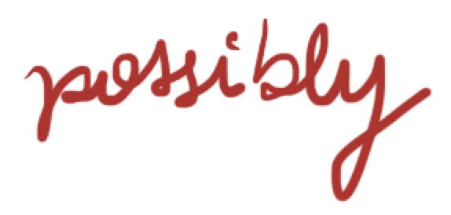
What are modalities?
That paper________________ good.

Slide 14
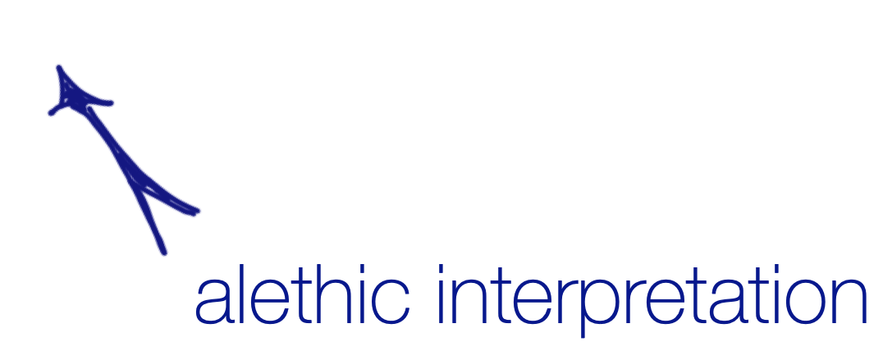
What are modalities?
That paper________________ good.

Slide 15

What are modalities?
That paper________________ good.

Slide 16
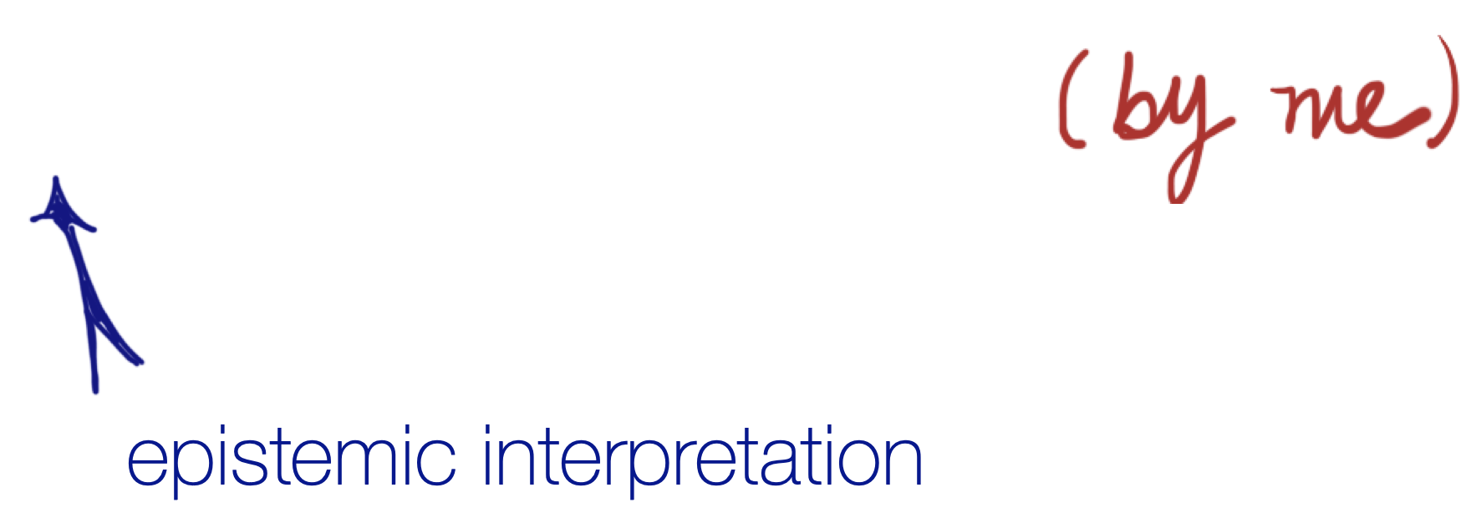
What are modalities?
That paper________________ good.

Slide 17
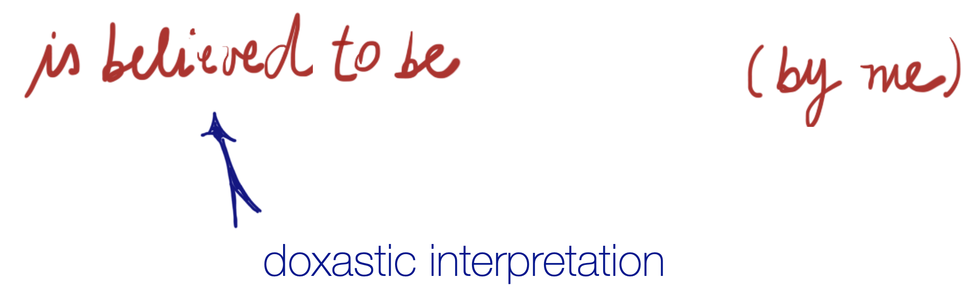
What are modalities?
That paper________________ good.

Slide 18
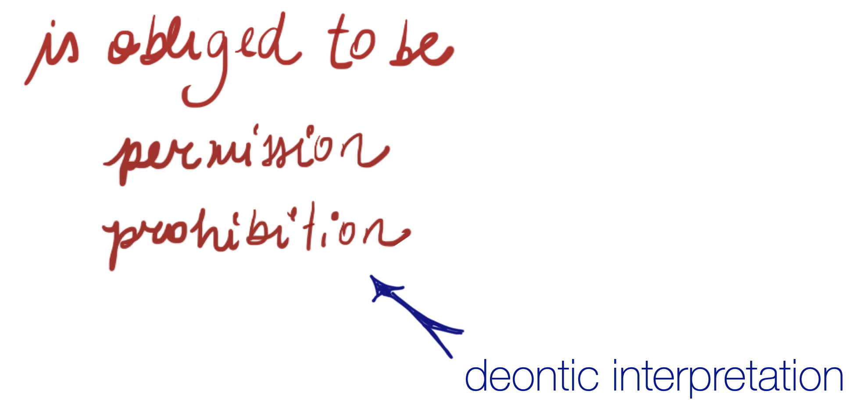
What are modalities?
That paper________________ good.

Slide 19
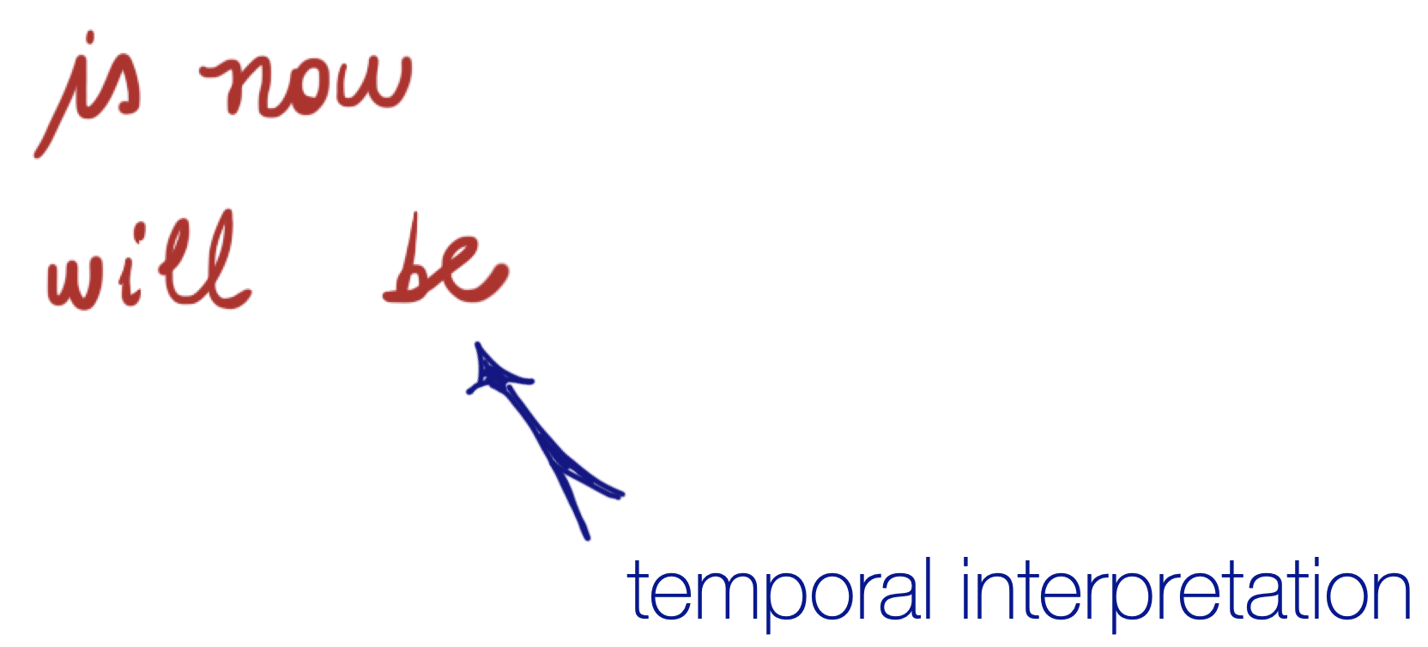
What are modalities?
That paper________________ good.

Slide 20

What are modalities?
That paper________________ good.

Slide 21
What are modalities?
That paper________________ good.

Slide 22
What are modalities?
p = That paper good.
p

Slide 23
What are modalities?
p = That paper good.
p
☐

Slide 24
What are modalities?
p = That paper good.
p

Slide 25
What are modalities?
p = That paper good.
p

Slide 26
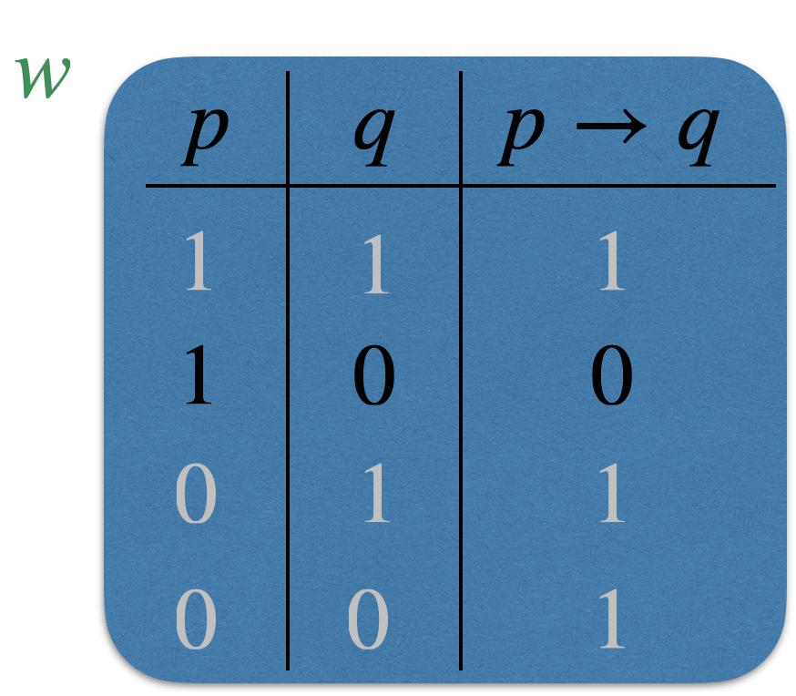
How to reason about modalities?
Truth tables

Slide 27
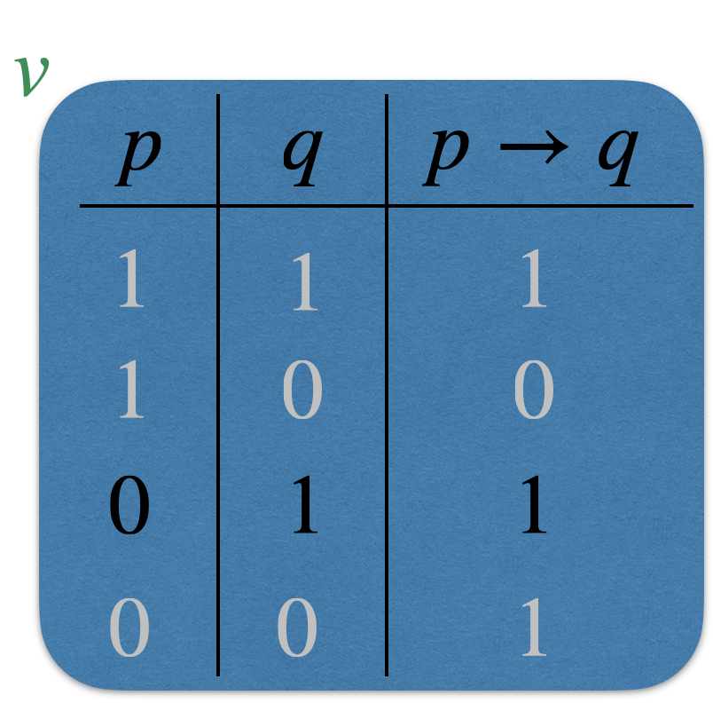
How to reason about modalities?
Generalising

Slide 28
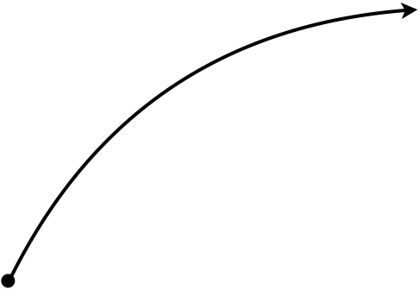
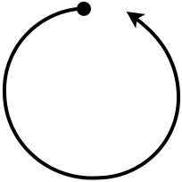
How to reason about modalities?
Adding relations

Slide 29

Et voilà un graphe!

Slide 30
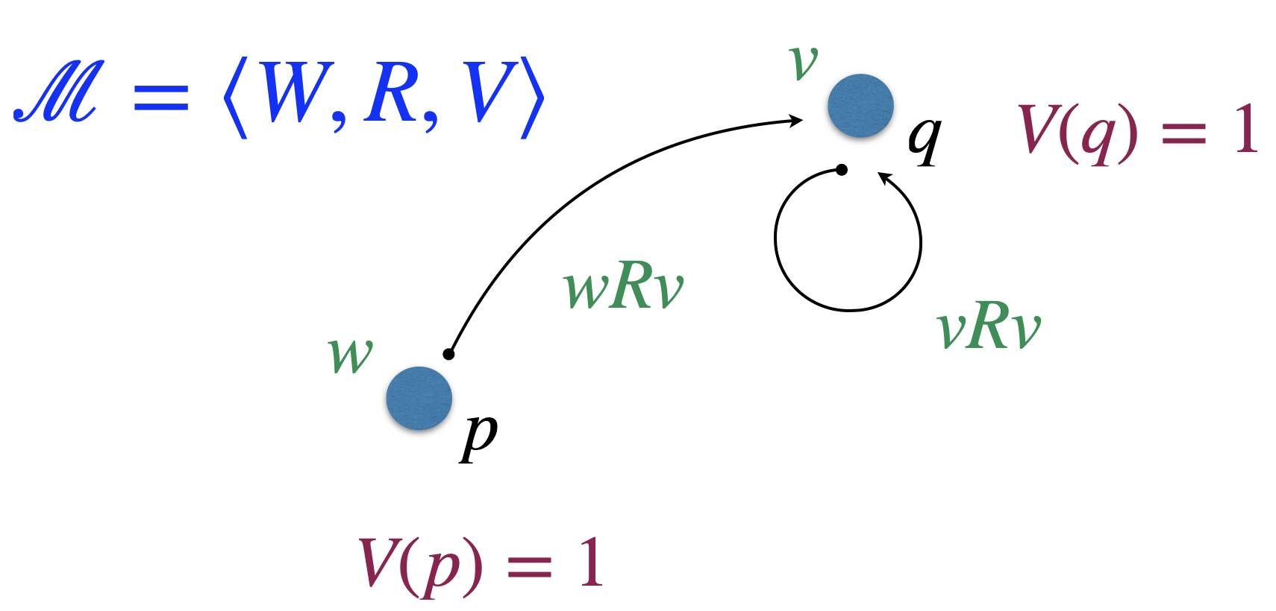
Relational models
For non-atomic propositional formulas:
Just check the truth table
in each world!

Slide 31
Relational models
𝜙 is necessary at a world w provided it
is true at every possible world from w.

Slide 32
Relational models
𝜙 is possible at a world w provided it
is true at some possible world from w.

Slide 33
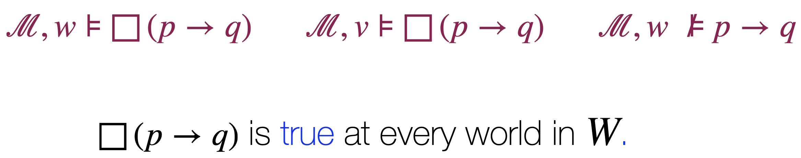
Relational models

Slide 34
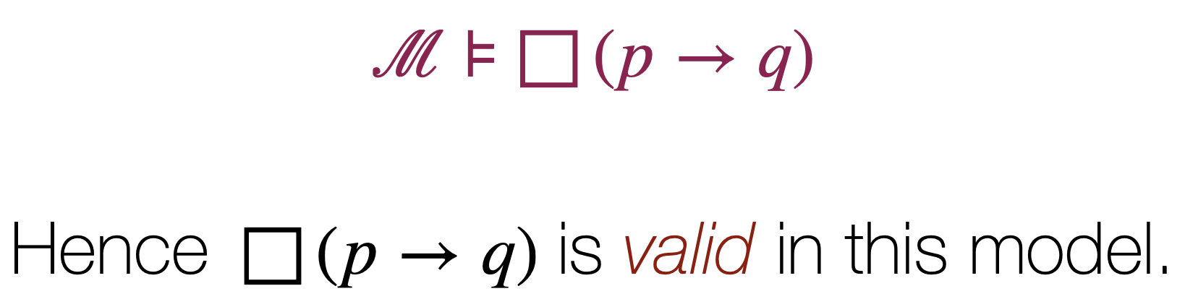
Relational models

Slide 35
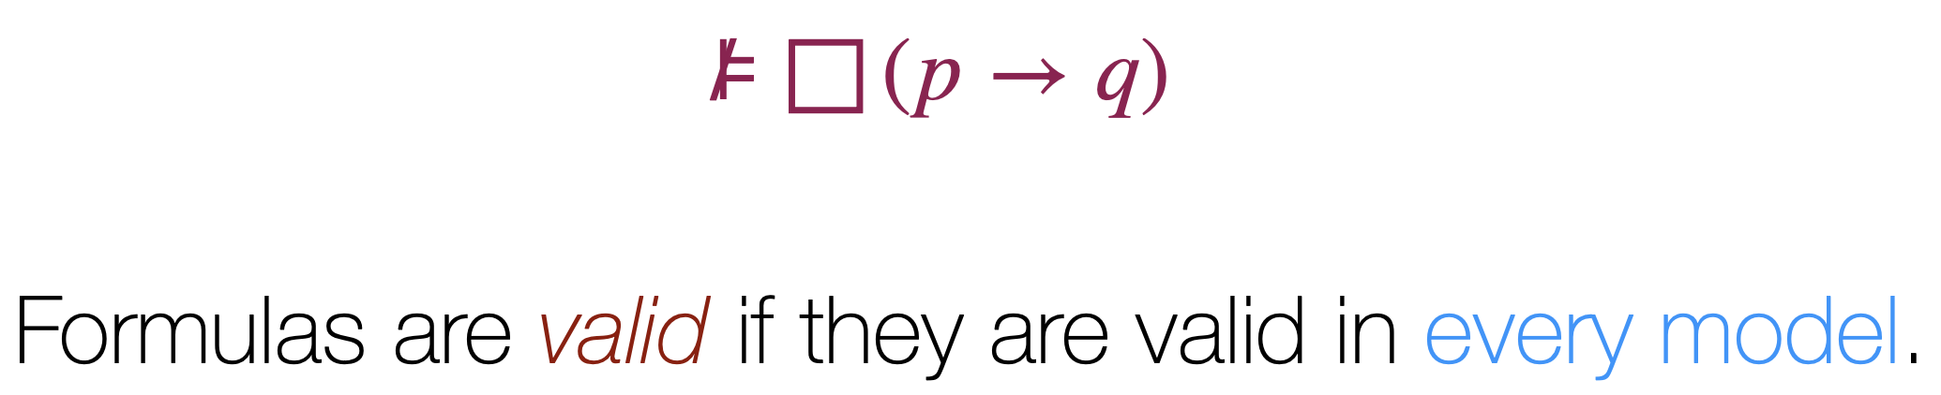
Relational models

Slide 36
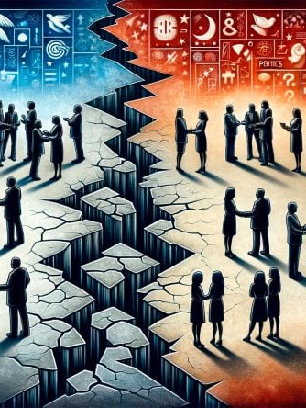
Polarisation
Notes:
bis hier: 22:40.
Betonen: zentraler eigenständiger Beitrag zur Diss

Slide 37
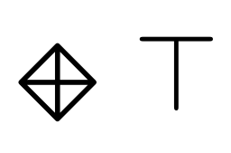
Agreement and disagreement relations
+
I have a friend (+): there exists a + successor.

Slide 38
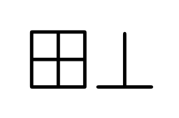
Agreement and disagreement relations
-
-
I don’t have friends (duality)

Slide 39
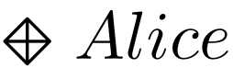
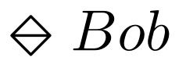
Agreement and disagreement relations
Bob
-
+
Alice
I’m friend of Alice
and enemy of Bob.

Slide 40
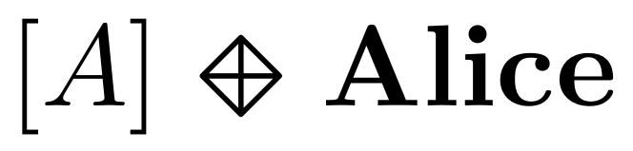
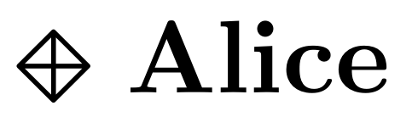
Agreement and disagreement relations
Everybody is friend of Alice
(global modality)
+
+
+
+
Alice

Slide 41
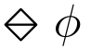
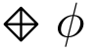
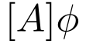
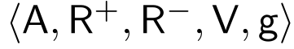
PNL Logic
holds for agent a whenever 𝜙 holds for some a’s enemy.
holds for agent a whenever 𝜙 holds for some a’s friend.
holds whenever 𝜙 holds for all agents
a R⁺ b: agent a agrees with (is a friend of) agent b
a R⁻ b: agent a disagrees with (is an enemy of) agent b
R⁺ is reflexive
R⁺ and R⁻ are symmetric.
These relations do not overlap
Optional axiom: collectively connectedness

Slide 42
Perspectives
relaxing symmetry;
valence weights between -1 and 1.

Slide 43

Dialogical Games

Slide 44
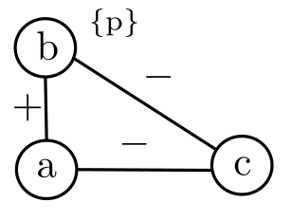


Semantic Game (truth in a model)
Proponent
F is true over 𝕄
Opponent
F is false over 𝕄
Model 𝕄
PNL
Semantic Game

Slide 45
Provability Game (truth in all models)
Playing over all models
Proponent
F is true over 𝕄
Opponent
F is false over 𝕄
PNL
Semantic Game
Provability Game

Slide 46
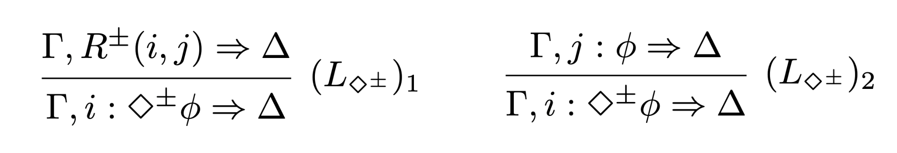
Analytic calculus
F is provable
F is not provable
PNL
Semantic Game
Provability Game
Sequent
Calculus

Slide 47
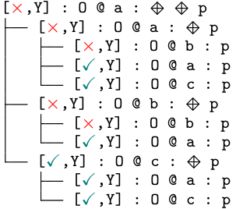

Our Contributions
Intended meaning
Dynamics
Satisfiability
Semantic Game
Towards automation:
Disjunctive states
Conditions for finiteness
Validity
Provability Game
Automatic procedures
Cut-free
Axioms as rules
Modular (different axioms)
Sequent Calculus

Slide 48
Semantic Game for PNL
Satisfiability : Played over a PNL model

Slide 49
Semantic Game for PNL
Satisfiability : Played over a PNL model
Players I and You claim the truth of a formula

Slide 50
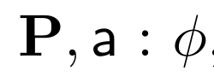
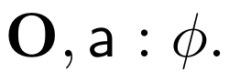
Semantic Game for PNL
Satisfiability : Played over a PNL model
Players I and You claim the truth of a formula
Game states:

Slide 51
Semantic Game for PNL
Satisfiability : Played over a PNL model
Players I and You claim the truth of a formula
Game states:
My and Your choices and strategies
P: Proponent
O: Opponent

Slide 52
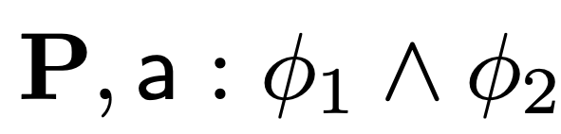
Semantic Game
Conjunction

Slide 53
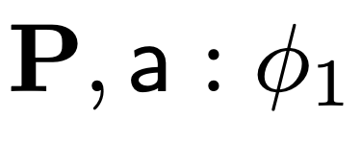
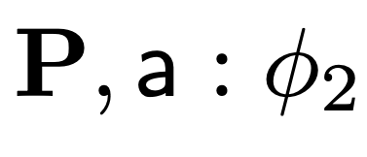
Semantic Game
Conjunction
YOU

Slide 54
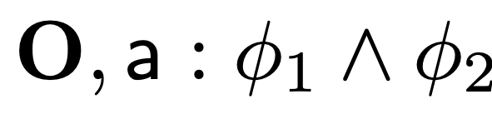
Semantic Game
Conjunction

Slide 55
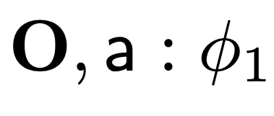
Semantic Game
Conjunction
ME

Slide 56
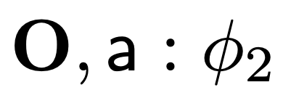
Semantic Game
Conjunction
ME

Slide 57
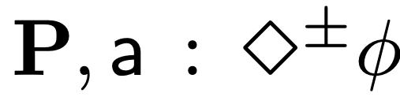
Semantic Game
Diamond

Slide 58
Semantic Game
Diamond
No a-successor, then you win

Slide 59
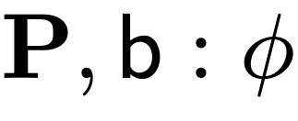
Semantic Game
Diamond
ME

Slide 60
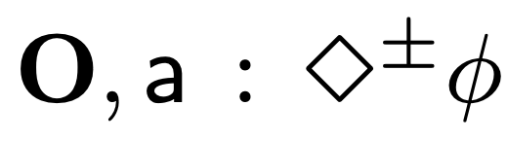
Semantic Game
Diamond

Slide 61
Semantic Game
Diamond
No a-successor, then I win!

Slide 62
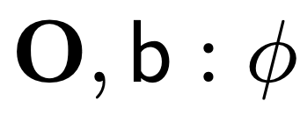
Semantic Game
Diamond
YOU

Slide 63
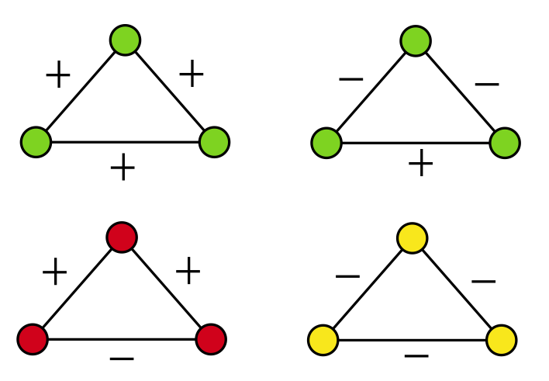
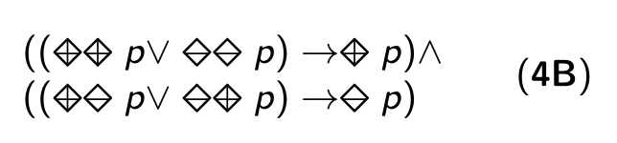
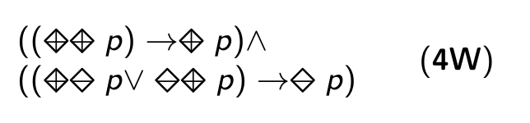
An example: Balance stable configurations
unstable: there is social pressure to change one of the relationship links;
stable: there is no social pressure to change.

Slide 64
An example: Balance stable configurations
If agent a is friends with both b and c, but b and c are enemies, then a will
be under pressure by both friends to choose sides, and b and c will be
under pressure to make amends.
In a triad with three mutual enemy relationships, there is pressure for
two of them to ally against the third.

Slide 65
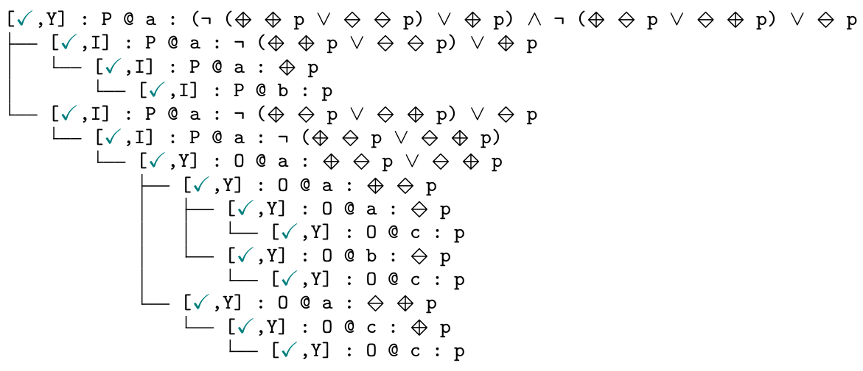
Dynamics: playing the game

Slide 66
Dynamics: playing the game

Slide 67
Dynamics: playing the game

Slide 68
Dynamics: playing the game

Slide 69
Dynamics: playing the game

Slide 70
Dynamics: playing the game

Slide 71
Dynamics: playing the game
I win!

Slide 72
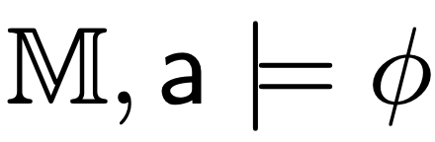
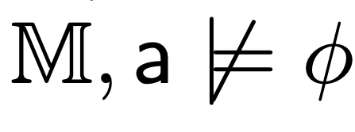
Semantic Game G_{𝕄}
Theorems
1. I have a winning strategy in 𝕄 for
iff
2. You have a winning strategy in 𝕄 for
iff

Slide 73
Semantic Game G_{𝕄}
Theorems
1. I have a winning strategy in 𝕄 for
iff
2. You have a winning strategy in 𝕄 for
iff
Similar adequacy result hold for all the games
presented here!

Slide 74
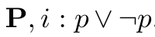
What about validity?
There is no uniform strategy for winning the game

Slide 75
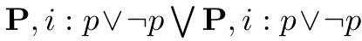
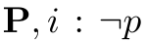
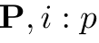

Disjunctive games
Validity/disjunctive game:
Multiset of game states.
The ability to duplicate states.
The model is relevant “only” in elementary states.
,
{
}
,
{
}

Slide 76
Disjunctive games
Disjunctive game DG(P, i : 𝜙) can be thought of as
Me and You
playing all semantic games G(P, i : 𝜙)
over all PNL-models 𝕄
,
{
}
Winning condition: I win (and you lose)
if for every PNL model there is an
elementary game state where I win
the semantics game.
,
{
}

Slide 77




A proof system
Frame axioms: Relational Rules

Slide 78


A proof system: Example
Collective connectedness

Slide 79
Dynamics
(Globally) adding new positive or negative links
(Locally) changing the polarity of one link
Extended PNL
Semantic Game
Provability Game
Sequent
Calculus

Slide 80




Example: reconciliation

Slide 81
Perspectives
Dynamic:
choose a triad at random;
if unstable, the valence of a random link in that triad is
‘flipped’ from positive to negative or vice versa.
Complete network:
universal harmony;
‘social mitosis’.
Networks not fully connected:
more than two factions;
mixed networks.

Slide 82

Resource awareness

Slide 83
Substructural logics

Slide 84
Substructural logics

Slide 85
Substructural logics

Slide 86
Substructural logics + multi-modality

Slide 87
Multi-modality

Slide 88
Multi-modality

Slide 89
Multi-modality

Slide 90
Multimodality as costs

Slide 91
Generalising...

Slide 92
Generalising...

Slide 93
Perspectives
games with budget (limiting the changes);
consensus within a limited “budget.”
more on automation (strategies and focusing).

Slide 94

To conclude

Slide 95
So far…
Advanced logical tools:
dynamic modal operators to model the evolution of social networks;
epistemic operators to reason about agents’ knowledge within these networks.
These logical frameworks:
enable a nuanced analysis of how networks change over time;
how agents interact and form beliefs about their environment.
This approach:
introduces a logical perspective to the subject;
offers a theoretical foundation that enhances the
understanding and regulation of socio-economic networks.

Slide 96
Perspectives 1
different update models in multi-agent systems can be
interpreted through modal logics lenses;
distance metrics between agents that can prioritize how agents
update their beliefs;
investigate how these preference orders can model biases in
social networks;
analyze the conditions under which consensus can emerge.
Carlos Olarte (Université Sorbonne Paris Nord) and
Fernando Velázquez-Quesada (University o f Bergen)

Slide 97
Perspectives 2
non-normal agents in social networks: to capture notions of
agency and ability, where P𝐴 is interpreted as “the agent can
bring about 𝐴”;
game-theoretical interpretation: “the agent has a winning
strategy to bring about 𝐴”.
Such interpretations are particularly relevant for formalizing
social networks within the framework of open systems.
dynamic game logic provides a powerful lens to conceptualize
processes as “games against the environment,” where agents
must adapt their strategies dynamically to account for
unpredictability.
Carlos Olarte (Université Sorbonne Paris Nord)

Slide 98
Perspectives 3
generate networks that can be used as case studies;
substructurality for studying scenarios where agents operate
with partial, conflicting, or shared information;
constraints imposed by dynamic environments;
study strategic negotiations, coalition formation, and the
structural evolution of social networks.
representation of resource sensitivity and locality, offering
a richer framework for reasoning about agent dependencies
and interactions.

Slide 99


Thanks!
Leverhulme project 2024 (ECUMENICAL)
European Union’s Horizon 2020 (Mosaic)

